Slide 1
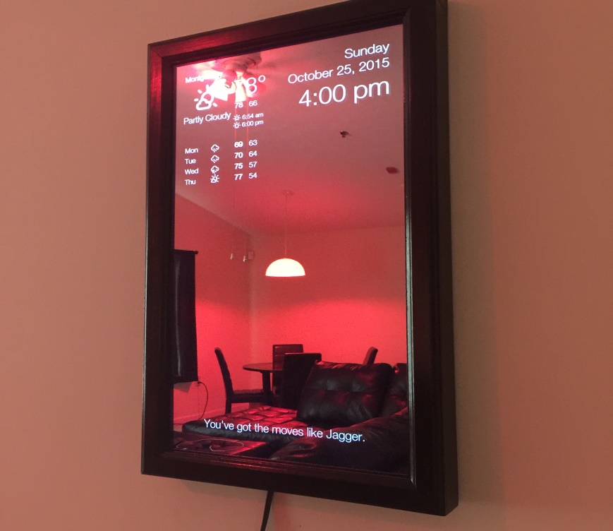

SMART MIRROR for Face & Voice Recognition
Aushapur(V) Ghatkesar(M) R.R Dist-501301
DEPARTMENT OF ELECTRONICS AND COMMUNICATION ENGINEERING
BATCH: AG-4
T. AISHWARYA (16P61A0406)
M. DILEEP KUMAR (16P61A0448)
P.JAYA SAI PRAGNA (16P61A0455)
GUIDE :
Dr. V. SHARMILA PROFESSOR

Slide 2
CONTENTS
INTRODUCTION
OBJECTIVE OF THE PROJECT
BLOCK DIAGRAM
FLOWCHART
STEPS TO ACHIEVE THE OBJECTIVE
HARDWARE REQUIREMENTS
SOFTWARE REQUIREMENTS
APPLICATIONS
ADVANTAGES
REFERENCES

Slide 3
INTRODUCTION
A smart mirror is a two-way mirror with an electronic display behind the glass. The display can show the viewer different kinds of information in the form of widgets, such as weather, time, date, and news updates.

Slide 4
OBJECTIVE
This project is to design a prototype, that acted as a “Smart Mirror” by displaying customizable information.
A “Smart Mirror” is a device that acts as a traditional mirror while also superimposing informational data, which can be customized by the user.
The mirror also allows for touch free user interaction with some of the data displays by using face and voice recognition. Users are able to customize the visual interface to display what specific data feeds they want.

Slide 5
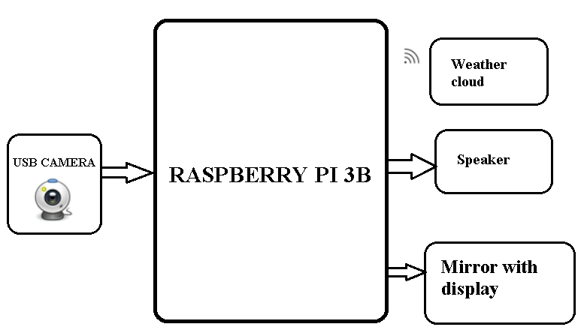
BLOCK DIAGRAM

Slide 6
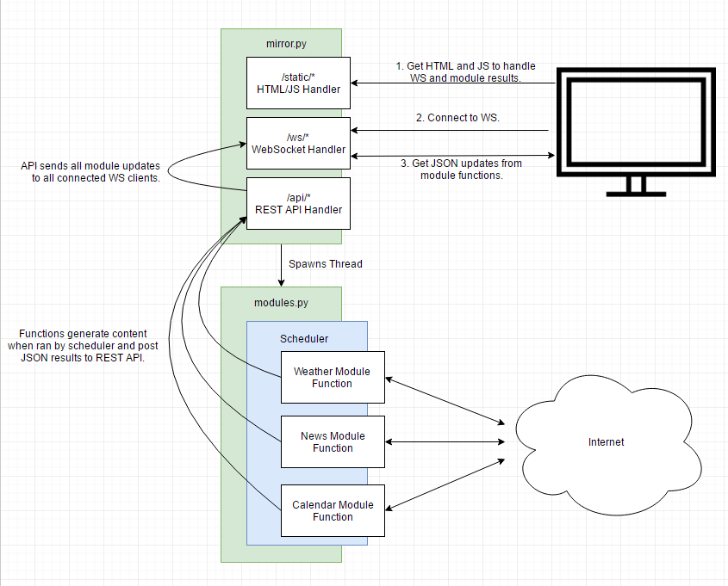
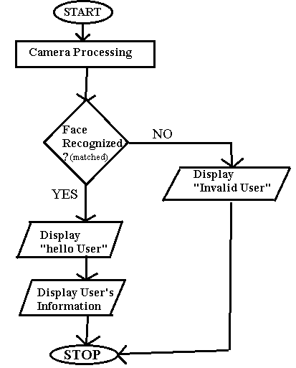
FLOWCHART
MIRROR
with Display

Slide 7
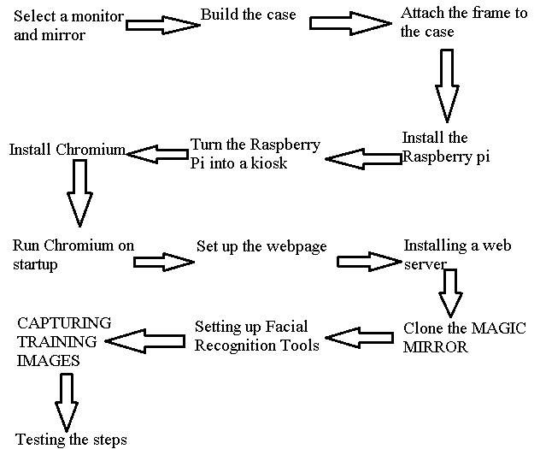
Steps Required
MAGIC MIRROR

Slide 8
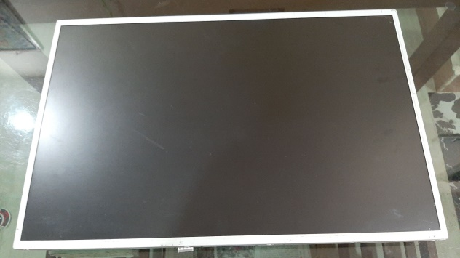
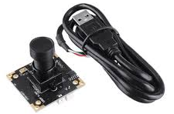
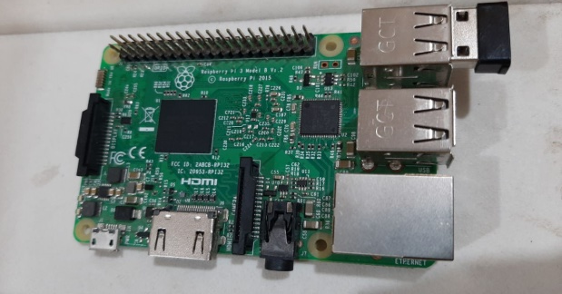
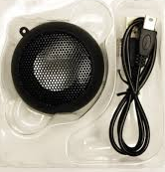
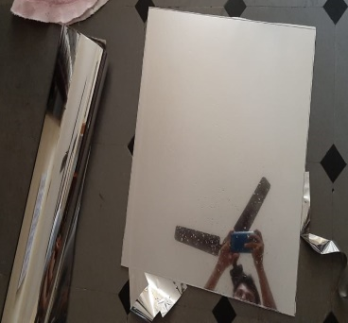
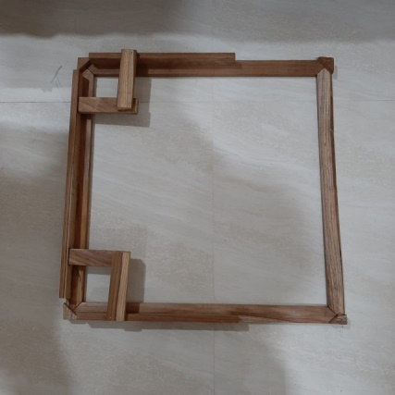
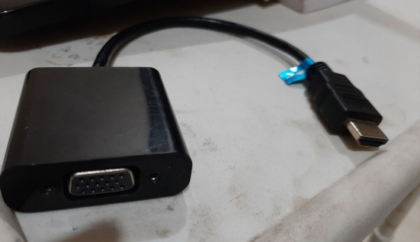
Hardware Requirements
Raspberry Pi 3 B
LCD Display (19’’ inchs)
ONE-WAY Mirror (20’’ * 20’’ inchs)
HDMI to VGA converter
Wooden strips (framework)
1080 HD USB Webcam or PI-cam
USB SPEAKER (8 kHz to 96 kHz)

Slide 9




Software Requirement
Developing tool : Python 3.7
Node JS
Raspbian OS
OpenCV

Slide 10
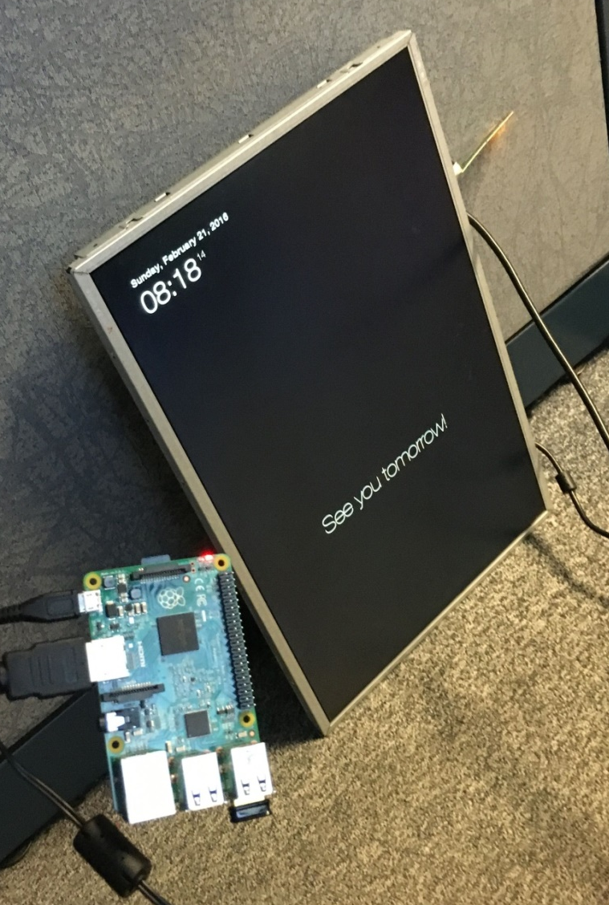
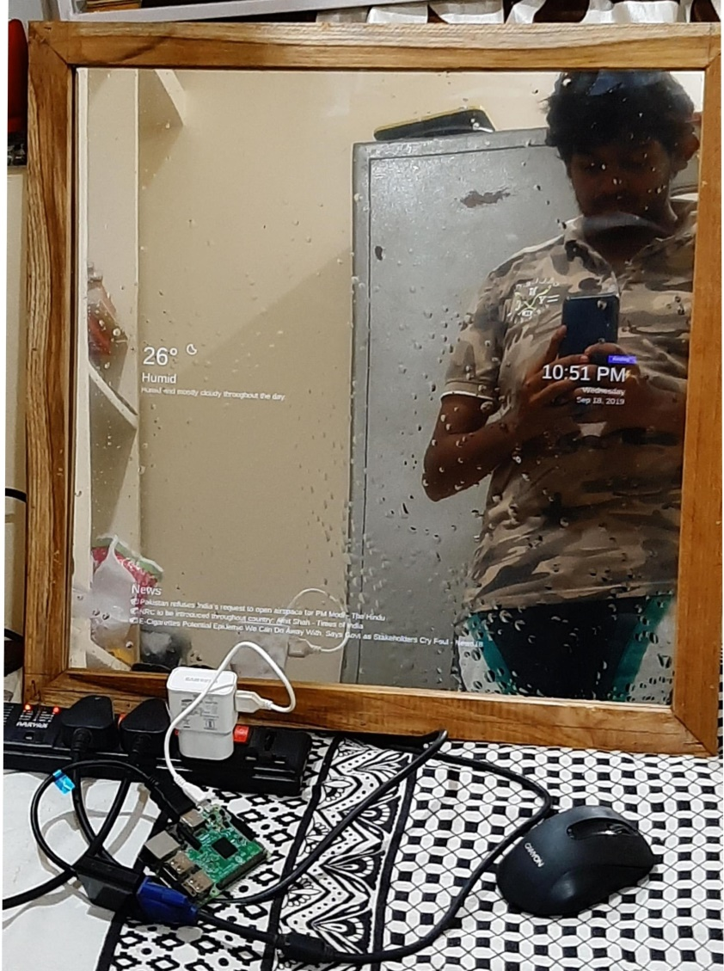
USER INTERFACE (UI)

Slide 11
Applications
Smart mirrors have many applications in both personal and social.
In personal:
It can be used to display relevant information.
Control household appliances
Provide emotional support to users.
In bathrooms, smart mirrors could prove to be a valuable application for many people
Breaking news show up on their smart mirrors seamlessly.
In social:
It can be used for advertisements and emergency alerts
Installed in ﬁtting rooms, a smart mirror could revolutionize clothes shopping.

Slide 12
Advantages
Useful for multi-tasker
Fast and easily accessible
Easily portable
Customizable UI
Easy to assemble

Slide 13
Future Scope
In Future, we will investigate how the surrounding context of the user and the environment can be utilized in order to provide optimal experiences. We, can be able to control Home appliances and lighting, even when we are getting ready for the day.

Slide 14
REFERENCES
B. Cvetkoska, N. Marina, D. C. Bogatinoska and Z. Mitreski, "Smart mirror E-health assistant — Posture analyze algorithm proposed model for upright posture," IEEE EUROCON 2017 -17th International Conference on Smart Technologies, Ohrid, 2017, pp. 507-512.
M. M. Yusri et al., "Smart mirror for smart life," 2017 6th ICT International Student Project Conference (ICT-ISPC), Skudai, 2017, pp. 1-5.
D. Gold, D. Sollinger and Indratmo, "SmartReflect: A modular smart mirror application platform," 2016 IEEE 7th Annual Information Technology, Electronics and Mobile Communication Conference (IEMCON), Vancouver, BC, 2016, pp. 1-7

Slide 15
THANK YOU

